Slide 1
DATA HANDLING

Slide 2
Data Types in Python
• Data types are used to identify the type of data and set of valid operations which can be performed on it.

Slide 3
• Python BUILT-IN core data types:
- Numbers( integer(whole no), floating(number with decimal)
- String
- List
- Tuple
- Dictionary

Slide 5
Numbers
Number data types are used to store numeric values.
Integer
• Signed Integer
• Booleans
Floating-point Numbers
Complex Numbers

Slide 6
Integers
int()
• Stores any integer(signed or unsigned) (big or small)
• e.g. -123, 1234
Booleans-
True or False
• 1 or 0

Slide 7
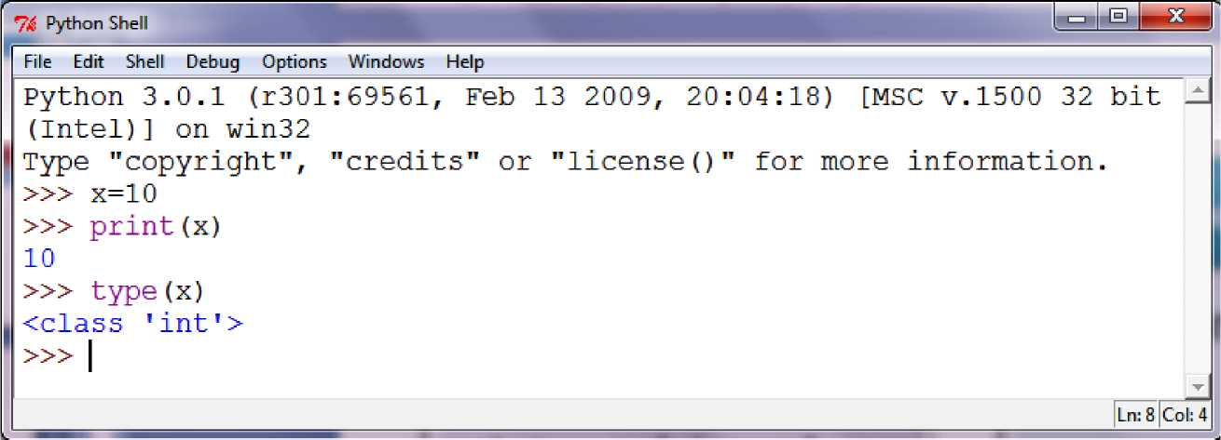
Example of integer datatype in Python

Slide 8
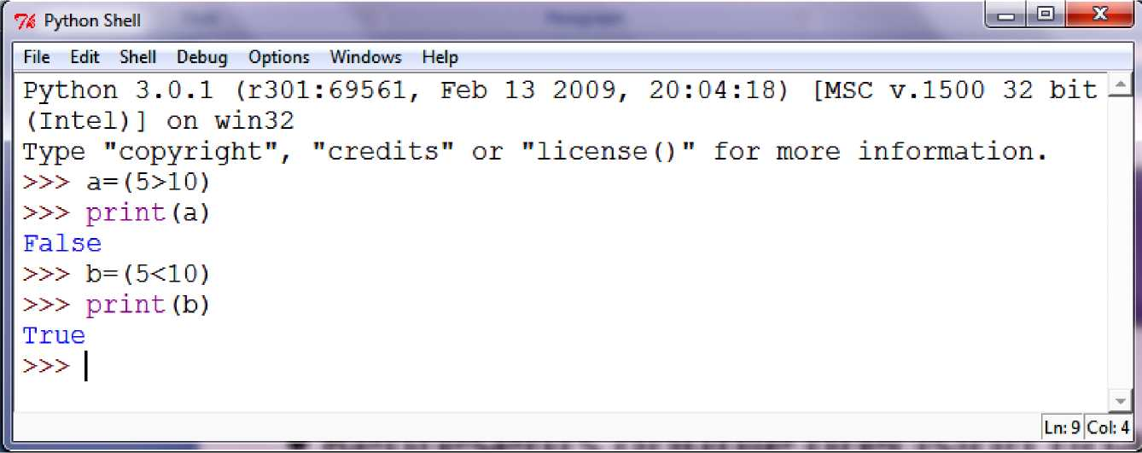
Examples of Boolean Expression in Python

Slide 9
Floating Point Numbers
• float()
• Represents double precision floating point numbers (15 digit precision)
• e.g. 12.345, -12.345

Slide 10
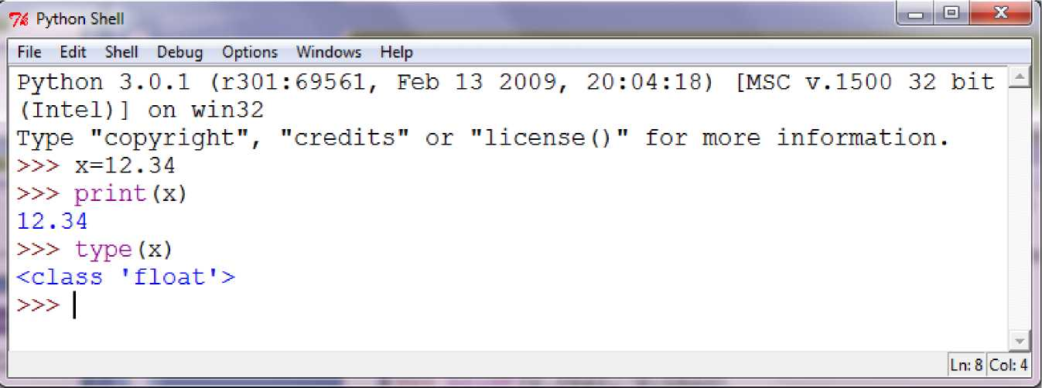
Examples of Floating Point Numbers in Python

Slide 11
Complex Numbers
❖Python represents Complex Numbers in the form A + Bj ❖Where, A & B are Real Numbers and j = V-1 (imaginary)
❖Real and imaginary part are internally represented as a pair of floating point numbers (float)
A is real part of the complex number Z = A + Bj
• Bj is Imaginary
part of the
complex number Z = A + Bj

Slide 12
Examples of Complex Numbers in Python
>>> x=5+4j
>>> print(x.real, x.imag)
5.04.0
>>> y=2-2j
>>> print (y. real, y.imag)
2.0 -2.0 " ~ “
>>> z=x+y
>>> print (z)
(7+2j)
>>> type(z)
<class ^{T}complex^{T}>

Slide 13
Range of Python Numbers
Integers
Unlimited range, subject to available (virtual) memory only
Booleans
Floating Point Numbers
Unlimited range, subject to available (virtual) memory on machine architecture
Complex
Numbers
Same as floating point numbers (Real and Imaginary Parts are represented as floats)

Slide 14
Strings
• In Python 3.x, all strings are a sequence of pure Unicode* Characters and each character can be individually accessed using its index
• A string can hold any known character like letters, numbers, special characters etc., of any known scripted language
• E.g. "abcd", "$@&%", '???', "1234", "apy”,
*Unicode is a system designed to represent every character from every language

Slide 15
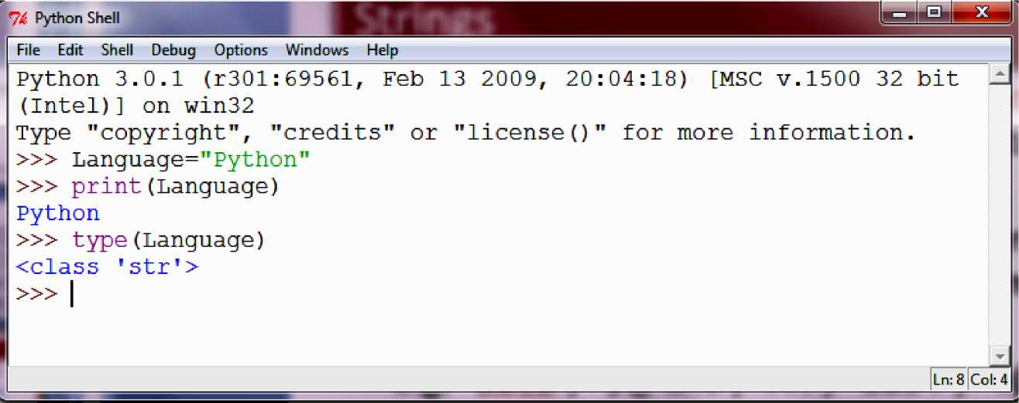
Example of Strings in Python

Slide 16
Lists
• A list in Python is represented as a group of comma-separated values of any datatype enclosed in square brackets.
• E.g. [1,2,3,4,5], ['Ankit', 101, 90.5], ['a', 'e', 'i', 'o', 'u']
• Elements in a List can be individually accessed using its index

Slide 17
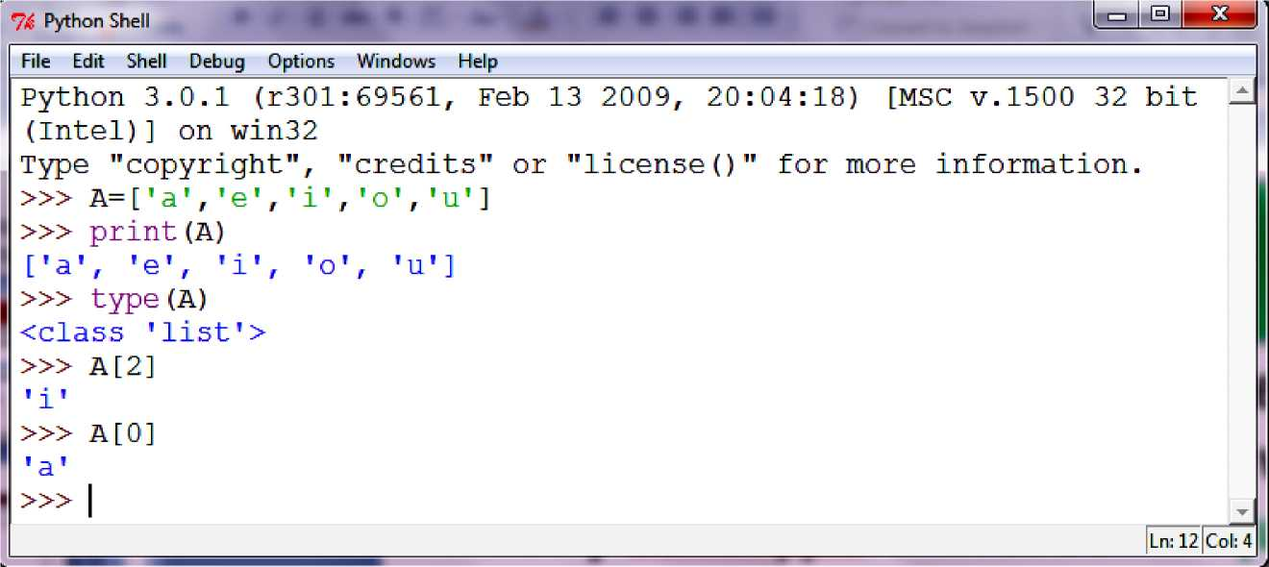
Example of Lists in Python

Slide 18
Tuples
• A tuple in Python is represented as a group of comma-separated values of any datatype enclosed within parentheses.
• E.g. A=(1,2,3,4,5), R=('Ankit', 101, 90.5), V=('a', 'e', 'i', 'o', 'u')
• Elements in a Tuple can be individually accessed using its index (Negative or Positive)
Positive Index
Tuple
Negative Index

Slide 19
»> tupl=(l,2,3,4)
»> print (tupl)
(1, 2, 3, 4)
»> type(tupl)
<class ’tuple’>
»> tup2=()
»> print (tup2)
»> tup3=(l,2,3,'a','b','c')
»> print (tup3)
(1, 2, 3, ’a’, ’b’, ’c’)
»> tup3[4]
’b’
»> tup3[-2]
’b’ "

Slide 20
Dictionaries
The dictionary in Python is an unordered set of comma-separated key:value pair enclosed within curly braces.
E.g. vowels ={'a':1, 'e':2, 'i':3, 'o':4, 'u':5}
Where, 'a', 'e', 'i', 'o', 'u' are the keys of dictionary vowels & 1,2,3,4,5 are the values for these keys respectively
Key: Value Pair => 'a' : 1

Slide 21
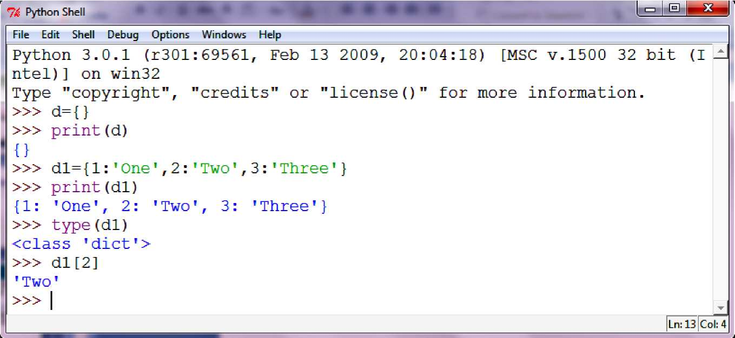
Example of Dictionaries in Python

Slide 22
Mutable and Immutable Data type
A mutable data type can change its state or contents
Immutable data type cannot change its state or contents .
Mutable data type:
list, dict, byte array
Immutable data type:
int, float, complex, string, tuple, bytes , set

Slide 23
Mutability can be checked with id() method.
x=10
print(id(x)) #id() is use to find the address of any variable
x=20
print(id(x))
#id of both print statement is different as integer is immutable

Slide 24
Boolean In Python
It is used to store two possible values either true or false
e.g.
str="comp sc"
b=str.isupper() # test if string contains upper case
print(b)
Output :-
False

Slide 25
Type conversion
The process of converting the value of one data type (integer, string, float, etc.) to another data type is called type conversion.
Python has two types of type conversion.
Implicit Type Conversion
Explicit Type Conversion

Slide 26
Implicit Type Conversion:
In Implicit type conversion, Python automatically converts one data type to another data type. This process doesn't need any user involvement.
e.g.
n = 12
f = 10.23
num_new = n + f
print("datatype of n:",type(n))
print("datatype of f:",type(f))
print("Value of num_new:",num_new)
print("datatype of num_new:",type(num_new))

Slide 27
Explicit Type Conversion:
In Explicit Type Conversion, users convert the data type of an object to required data type. We use the predefined functions like int(),float(),str() etc.

Slide 28
Type Conversion of Integer
int() function converts any data type to integer.
e.g.
a = "101" # string
b=int(a) # converts string data type to integer.
c=int(122.4) # converts float data type to integer.
print(b)
print(c)
Output :-
101
122

Slide 29
Type Conversion of Floating point numbers
Floating point numbers is a positive or negative real numbers with a decimal point
float() function converts any data type to floating point number.
e.g.
a='301.4' #string
b=float(a) #converts string data type to floating point number. c=float(121) #converts integer data type to floating point number. print(b)
print(c)
Output :-
301.4
121.0

Slide 30
Explicit Type Conversion
e.g.
n = 12
s = "45"
print("Data type of n:",type(n))
print("Data type of s before Type Casting:",type(s))
s = int(s)
print("Data type of s after Type Casting:",type(s))
num_sum = n + s
print("Sum of num_int and num_str:",num_sum)
print("Data type of the sum:",type(num_sum))

