Slide 1
Tokens in Python
► The smallest unit/element in the python program/script is known as a Token or a Lexical unit.
► Python has following Tokens:
► Keywords
► Identifiers
► Literals
► Operators
► Punctuators

Slide 2
Keywords
Keywords are the reserve words/pre-defined words/special words of python which have a special meaning for the interpreter.
False | True | None | def | if
lambda | class | yield | continue | else
assert | or | while | break | elif
del | from | is | not | pass
for | global | finally | import | as
in | nonlocal | return | With | And
int | except | Raise | print

Slide 3
Identifiers(user defined names)
► Identifiers are the name given to the different programming elements like variables, objects, classes, functions, lists, dictionaries etc.
Non- | Rule 2 | • Must be | Rule 3 | • Cannot
keyword |  | made up of |  | begin
word |  | only letters, |  | with a
with no |  | numbers |  | Number,
space in |  | and |  | although
between |  | Underscore(_) |  | may contain
 |  |  |  | numbers
Rule 1

Slide 4
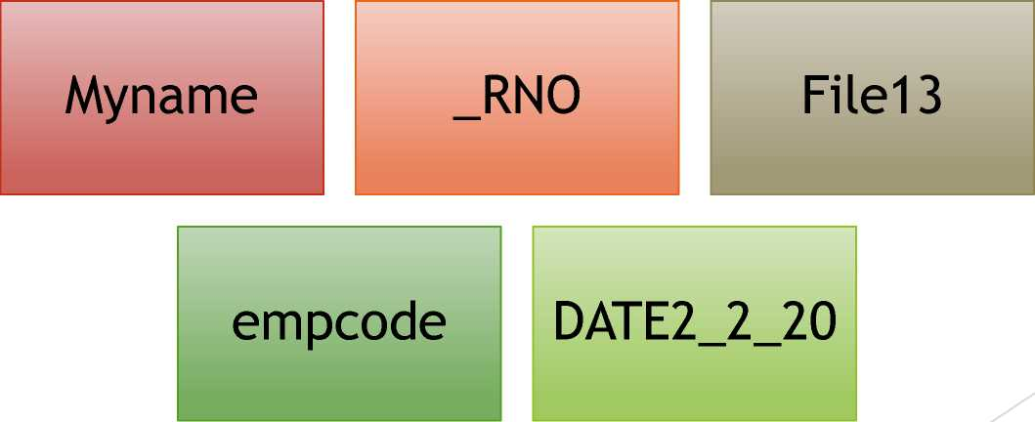
Identifiers
\
Some Valid Identifiers:

Slide 5
Literals
► Literals are the data items that have a fixed or
constant value

Slide 6
String Literals
► A string literal is a sequence of characters surrounded by Quotes (Single, Double or Triple Quotes).
Single Line Strings
MultiLine Strings
• Must terminate in one line
Spread
across
multiple
lines

Slide 7
String Literals
Single line String
>>>Txt1 = “Hello World”
Multiline string
>>>Txt2 = “Hello\
World”
>>>Txt3 =‘’’Hello World”’

Slide 8
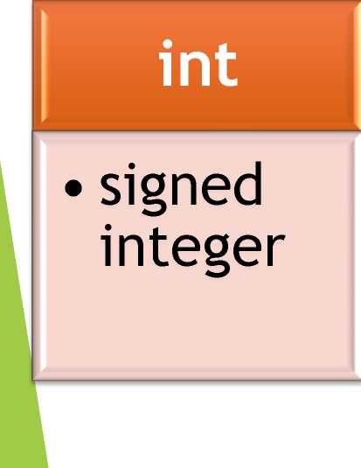
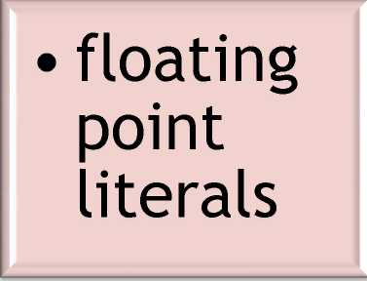
Numeric Literals
► Numeric Literals are numeric values like integer floating point number or a complex number
float
complex
complex number literals

Slide 9
Numeric Literals
► integer literals
Decimal
Form
Octal Form
Hexadecimal
form
• Digits 0-9
• Base 10
• e.g. 1234
• Begin with Oo
• Base 8(0-7)
• e.g. 0o32
• Begin with Ox
• Base 16(0-9,a-f)
• e.g.OxAF

Slide 10
Numeric Literals
► Floating Point Literals/ Real Literals & Complex Numbers
Floating point | n | Complex Number
• Decimal point |  | • a+bj form
divides the |  | • a & b are real
integer and fraction part |  | • j = v-1, imaginary • e.g. 2+3j
• e.g. -13.0, 3.E2, 0.17E5

Slide 11
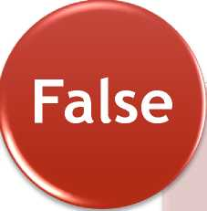
Boolean Literals
► A Boolean literal in Python is used to represen one of the two Boolean Values i.e. True or False
Boolean
True
Boolean
False

Slide 12
Special Literal – None(empty legal value)
In python, None literal is used to indicate absence of value

Slide 13
Identifiers
Some Invalid Identifiers:
VID-REC
• Contains special character -(hyphen)
2020RNO
• Starting with a Digit
continue
• Reserved keyword
Emp.Code
• Contains special character . (dot)

Slide 14
Operators in Python
► Operators are the symbols or words that perform some kind of operation on given values (operands) in an expression and returns the result.
arithmetic | +,-,/,*,%,**,//
bitwise | • &, ^, |
identity | • is, is not
relational | •>,<,>=,<=,==,!=
logical | • and, or,not
shift | • <<, >>
Assignment | • =
Membership | • in, not in
arithmetic-assignment | +=,-=,//=,**=,*=,/=

Slide 15
Punctuators in Python
► Punctuators are the symbols that are used in programming language to organize sentence structure, indicate the rhythm and emphasis of expressions, statements and Program Structure.
► Common Punctuators are:
‘ ‘’ “”
#
\
( ) { } [ ]
@ ,
, : . ;

Slide 16
Tokens in Python
Keywords are the reserve words of python which have a special meaning for the interpreter.
Identifiers are the name given to the different programming elements like variables, objects, classes, functions, lists, dictionaries etc.
Literals are the data items that have a fixed /constant value.
Operators are the symbols or words that perform some kind of operation on given values (operands) in an expression and returns the result.
Punctuators are the symbols that are used in programming language to organize sentence structure, indicate the rhythm and emphasis of
expressions, statements and Program Structure.

